Slide 1
Anaplan RPM Applications
FY26 Implementation Enablement Workshop

Slide 2
Day 1: 9:00AM – 5:00PM
Topic | Time
Introductions and Agenda | 9:00 – 9:15 (15mn)
SPM Overview / Anaplan Way for Apps / Implementation Guide | 9:15 – 10:15 (60mn)
T&Q Configuration Overview | 10:15 – 11:15 (60mn)
T&Q Configuration Exercise | 11:15 – 12:00 (45mn)
Break & Lunch | 12:00 – 1:00 (60mn)
T&Q Configuration Exercise (cont.) | 1:00 – 1:30 (30mn)
Post Generation Steps | 1:30 – 2:00 (30mn)
Data Integration / ADO | 2:00 – 2:30 (30mn)
Break | 2:30 - 2:45 (15mn)
T&Q Spoke Review and Exercise | 2:45 – 4:15 (90mn)
Common Extensions | 4:15 – 4:45 (30mn)
Day 1 Conclusion and Feedback | 4:45 – 5:00 (15mn)

Slide 3
Day 2: 9:00AM – 4:15PM
Topic | Time
Segmentation Configurator Review | 9:00 – 9:45 (45mn)
Capacity Configurator Review | 9:45 – 10:30 (45mn)
Configurator Exercise | 10:30 – 12:00 (90mn)
Break and Lunch | 12:00 – 1:00 (60mn)
Post Generation Prep | 1:00 – 1:30 (30mn)
Segmentation and Capacity UX Walk Through | 1:30 – 3:00 (90mn)
What is Coming in RPM Apps | 3:00 – 4:00 (60mn)
Day 2 Conclusion and Feedback | 4:00 – 4:15 (15mn)

Slide 4


Who you are stuck with today
Chan Duh
RPM Delivery Advisor
Jon Newcomb
Revenue Performance Application Lead

Slide 5
Enablement Objectives
SPM Understanding
Application Offerings/Demo
How Configurator works
A high-level understanding of Sales Performance Management and why it matters for Anaplan
Being able to showcase the application with the template models/apps
Understand what the critical inputs are for the configurator and what is required to generate the application
App Implementation
Showcase to customers
How we can support you
Know the flow of implementation involving the application configurator
Able to articulate the offering of current SPM apps to prospects and customers
Know what is available and how the application team can assist you in your enablement and implementation journey

Slide 6
Sales Performance Management (SPM) Overview

Slide 7
Sales Performance Management
What is SPM?
Key Areas
SPM is a suite of tools and processes designed to improve sales effectiveness and efficiency by managing sales strategies, performance metrics, and compensation systems.
Territory and Quota Management (TQM/T&Q)
Account Segmentation and Scoring
Capacity Planning
Sales Forecasting
Incentive Compensation Management (ICM)

Slide 8
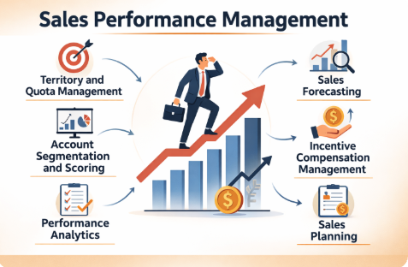
Why is SPM Important
Revenue Growth: Aligns sellers, quotas, and incentives to maximize attainment.
Fairness & Trust: Transparent quotas and pay motivate and retain reps.
Agility: Enables mid-cycle adjustments to stay ahead of market shifts.
Executive Confidence: Accurate forecasts build credibility with leadership & investors.

Slide 9
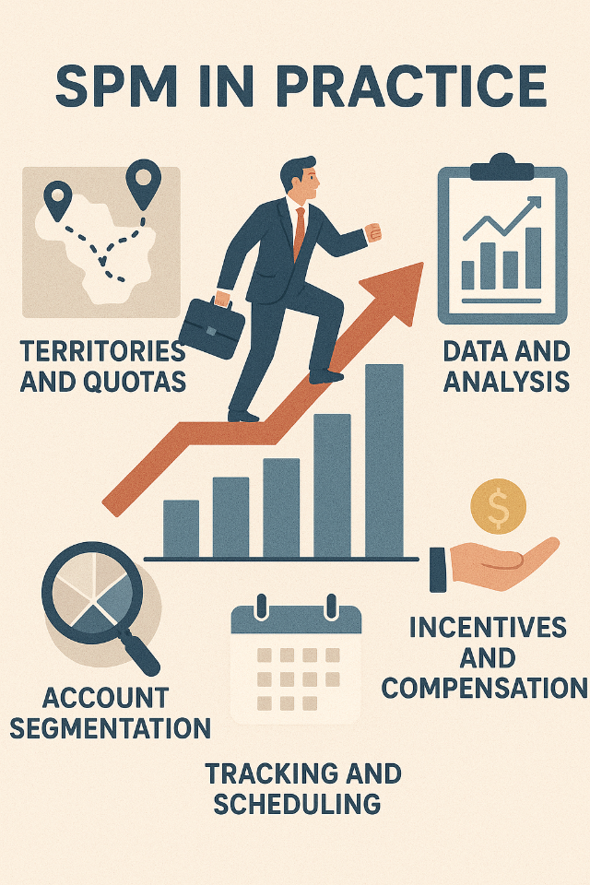
SPM in practice
Territory & Quota: Balanced coverage and achievable quotas.
Segmentation & Scoring: Focus on high-value accounts with data-driven insights.
Capacity Planning: Align headcount and resources to growth goals.
Forecasting: Pipeline visibility and predictive insights for proactive action.
Incentives: Pay-for-performance that drives the right behaviors.
Notes:
Integrating Data across multiple sales(CRM), finance(ERP), and HR(HRIS) systems
Automate performance management workflows
Providing visibility into sales performance, territories, and compensation

Slide 10
Territory and Quota Planning/Management

Slide 11
Territory Management
What is Territory Management?
Territory Management Benefits
Territory Management is the process of defining and allocating sales territories to ensure balanced market coverage. The goal is to match selling resources with market opportunity, so each territory is equitable and achievable. Effective territory management reduces coverage gaps, prevents overlaps, and ensures reps are focused on the right regions, industries, or accounts.
Optimized Coverage
Reduced Overlap & Conflict
Increased Productivity
Balanced Workload
Revenue Potential Realized
Notes:
Optimized Coverage: Ensures every market, region, or segment has fair and complete coverage.
Reduced Overlap & Conflict: Minimizes disputes between reps by clarifying ownership.
Increased Productivity: Directs reps toward the best-fit opportunities.
Balanced Workload: Prevents overloading some reps while others are underutilized.
Revenue Potential Realized: Unlocks untapped markets and avoids gaps in coverage.

Slide 12
Quota Management
What is Quota Management?
Quota Management Benefits
Quota Management is the process of setting and distributing sales targets across the organization. Quotas are aligned with corporate revenue goals and tailored to territory potential, rep experience, and historical performance. Strong quota management ensures fairness, motivates sellers, and provides leadership with confidence in achieving top-line goals.
Fair & Attainable Targets
Alignment with Strategy
Improved Performance Tracking
Motivation & Retention
Predictable Revenue
Notes:
Fair & Attainable Targets: Builds trust and maintains motivation among reps.
Alignment with Strategy: Connects individual goals to company revenue objectives.
Improved Performance Tracking: Provides visibility into who is on track and where support is needed.
Motivation & Retention: Drives desired behaviors through achievable goals and clear expectations.
Predictable Revenue: Increases accuracy in forecasting and organizational confidence.

Slide 13
T&Q Challenges
Challenges in Territory Management
Challenges in Quota Management
Inequitable Territories
Overlaps & Gaps
Static Territory Design
Data Quality Issues
Complexity at Scale
Unrealistic Quotas
Misalignment with Opportunity
Slow Planning Cycles
Lack of Transparency
Frequent Mid-Cycle Adjustments
Notes:
Challenges in Territory Management
Inequitable Territories: Some reps get high-potential markets while others are left with limited opportunity.
Overlaps & Gaps: Ambiguous boundaries lead to conflicts between reps or leave customers uncovered.
Static Territory Design: Territories fail to keep up with market shifts, mergers, or rep turnover.
Data Quality Issues: Inaccurate or incomplete account data undermines fair allocation.
Complexity at Scale: Global or large orgs struggle to balance thousands of accounts across regions.
Challenges in Quota Management
Unrealistic Quotas: Targets set too high demotivate reps; too low reduce revenue potential.
Misalignment with Opportunity: Quotas don’t reflect territory size, market potential, or rep experience.
Slow Planning Cycles: Manual, spreadsheet-driven quota setting delays the sales year kickoff.
Lack of Transparency: Reps don’t understand how quotas are set, leading to distrust.
Frequent Mid-Cycle Adjustments: Poorly designed quotas require constant rework, disrupting execution.

Slide 14
T&Q Key Elements
Where to sell
How much to sell
Territory Design/Coverage Model
Market potential analysis to balance opportunity
Account allocation& Ownership clarity
Ongoing maintenance as market and teams shift
Quota setting methodology (top-down vs. bottom-up)
Fairness & attainability tied to territory potential
Distribution across regions, teams, and reps
Strategic alignment (growth areas, products, segments)
Tracking, transparency, and flexibility for adjustments

Slide 15

Anaplan Territory and Quota Planning Application Out-of-the-box
Target Allocations
Input, adjust, override, and lock targets using top-down and bottom-up approaches with dynamic approvals and final roll-up alignment.
Key Benefits:
Align territories and quotas using historical and forecasted data
Adapt sales plans with dynamic, scenario-based modeling
Improve coverage with flexible rep assignments and geo-planning
Assign quotas by role with ramping and seasonal flexibility
Streamline workflows with approvals and effective dating
Compare what-if scenarios to guide smarter, faster decisions
Scenario Planning
Build dynamic, driver-based sales plans by segment, product, or role. Model and compare full-year projections and growth strategies
.
Assign: Account-to-Territory Model account redistribution scenarios, support multi-territory assignments, and plan geographically with zip code mapping
Assign: Quota
Assign and allocate flexible quotas using role-based, ramping, or seasonal factors. Compare top-down vs. bottom-up targets and finalize with approvals
Assign: Rep-to-Territory Assign sales teams and overlays by role, manage temporary or player/coach assignments, and create hierarchies from sales relationships.
Sales Margins Planning
Model role-specific costs and sales margins to boost profitability.
In-Year vs Actual Plan
Lock plans, compare snapshots, and optimize coverage.
Notes:
The Anaplan GTM Capacity Planning Application includes the following components:
HC Gap Analysis: Evaluate HC needs based on account volume, revenue targets, and historical data while aligning with financial goals
Top-Down Planning: Distribute HC targets, simulate scenarios, and optimize allocation and approvals.
Bottom-Up Planning: Track trends in hiring, attrition, and productivity and run scenarios to adapt plans.
Sales Margins Planning: Capture role-specific cost data and model dynamic sales margins to improve profitability.
In-Year vs Actual Plan: Lock plans for data integrity, adjust, and compare snapshots to optimize coverage.
Baseline Productivity: Evaluate productivity vs. quota attainment to optimize targets and resource allocation.
Coverage Analysis: Balance HC allocation while adjusting sales coverage in real time to address gaps.
Role-Based Reviews: Analyze performance to gain actionable insights for improving role effectiveness.
Current FTE Reporting: Access HC and FTE data and simulate "what-if" scenarios with employee-level insights.
As a customer, this applications empowers you with sped and agility to quickly:
Optimize FTE and HC allocation for maximum efficiency.
Enhance planning with insights into sales and ramp trends.
Predict and mitigate turnover by forecasting attrition.
Enable real-time scenario modeling and performance tracking.
Align headcount with budgets to maintain cost control.
Monitoring new hire success through impact analysis.

Slide 16

















High-Level The Anaplan Way for Applications
Base Application Go-Live
Test and Deploy
Baseline Application Configured
Project Kick-Off
No Extensions
Prod Data Loaded
SIT / UAT
Post Deploy Support
Pre-Project
Configuration
Extended Application Go-Live
Application-Led Design
Iterative
Extensions
Extensions Identified
Aligned Scope
Signed SOW
Data Validation
Application Configuration
Application-Led Workshops
Extension Design
Extension Build
Test and Deploy
Manual Data Loads
Write User Stories
Confirm Design & Plan
Execute Sprints
Prep for Testing
Prod Data Loaded
SIT / UAT
Post Deploy Support
Automated Data Loads

Slide 17
The Anaplan Way for Applications
EXTENSION PHASES
Pre-Project
Configuration
Test & Deploy
Extension Design
Extension Build
Ext Test & Deploy
Discovery Workshop
Project Success Criteria
Review Planning Metrics
Review Business Processes
Review Functional Scope
Application Mapping (Business Need vs Application Coverage)
Data Readiness & Template Review
Training of Key Users
Signed SOW
Sales to Delivery Handoff
Sales Assets
Data
Analyze Customer Data
Data Strategy and Mapping
Application Config & Design
Configure Application
Review Data / Planning Granularity
Upload Customer Data into Application
List and Hierarchy Validation
Conduct App-Led Design Workshops (Interactive Walk-through Session of the Base Application)
Manage Security
Document High-Level Extension Possibilities
Data Validation
Configurations Close Checklist Completed
Configuration Phase Project Plan Signed Off
Application Ready for Production
Finalized Application Walkthrough
Data Validation
Systems Integration Testing (SIT)
User Acceptance Testing (UAT)
Preparation for go-Live
Production Data Loaded
Base Application UAT Signed Off
Application Deployed to Production
Base Application Go-Live
Prepping for Extensions
Extension Design Kick-off
Detailed Review of Business Needs from App-Led Design Workshops
Create User Stories
Create Extension Design Document
Confirm Project Plan for Implementation
Extension Design and Implementation Plan Signed Off
SOW/Change Order Signed
Executing the Plan
Execute Sprint Plan
Update SIT Plan
Update UAT Plan
Update Admin Training
Update User Guide to Include Extensions
Functional Unit Testing Passed
Customer Approval to move to SIT and UAT
Production Data Loaded
Extension Ready for Production
Test Scripts Created
Superuser Train-the-Trainer Sessions
Execute SIT
Execute UAT
Testing Defect Resolution and Backlog Confirmation
Preparation for Go-Live
Post Go-Live Support Plan Confirmed
SIT Signed Off
UAT Signed Off
Application Deployed to Production
Application Go-Live!
Activities
Control Gates

Slide 18
The Anaplan Way for Applications – Base Application + Extension Deployment
Pre-Project
Configuration
Extension Design
Extension Build
Ext Test & Deploy
Discovery workshop
Project success drivers
Review planning metrics
Review functional scope
Review business processes
Application mapping (business need vs application coverage)
Data readiness & template review
Training of key users
Signed SOW
Sales Assets
Sales to Delivery Handoff
Data
Analyze customer data
Data strategy and mapping
Application Config & Design
Conduct App-Led Design Workshops
Upload customer data into application
Review data / planning granularity
Manage security
Configure application
Extension / additional use-case design and prioritization
Interactive walk-through session of the base application with customer
Data Validation
Configurations Close Checklist Completed
Configuration Phase Project Plan Signed Off
Extension Design
Extension Design Kick-off
Detailed review of business needs from App-Led Design Workshops
Design and Implementation Plan for Additional Functionality
Create user stories
SOW/Change Order Signed
Extension Build
Sprint plan execution
Update SIT plan
Update UAT plan
Update admin training
Update user guide to include extensions
Functional Unit Testing Passed
Production Data Loaded
Customer Approval to move to SIT and UAT
Extension ready for production
Application guide review
Data validation
List and hierarchy validation
End to end data flow testing
Test Scripts Created
Superuser train the trainer sessions
Systems integration testing
User Acceptance Testing
UAT resolution and backlog management
Preparation for go-Live
Support through agreed number of cycles
Production data loaded
SIT Signed Off
UAT Signed Off
Go-Live!
Activities
Control Gates

Slide 19
Workshops Agenda, Participants, and Outcomes
Session | Title | Purpose | Participants | Pre-Requisites / Materials | Pre-Requisites Anaplan
0 | Data & Integrations ​ | Confirm input and output data sources Identify source & target systems​ Review file structure & format and interface approach​ Identify data owners | SMEs & IT​ |  | Anaplan standard templates with instructions​ ​
1 | Solution Introduction & Foundational Kick-Off | Introduction to the implementation approach | Anaplan SIM/PM to lead Project Team (Business users, SMEs, etc.) to attend |  | Project Kick-Off Deck and list of Foundation Workshops
2 | Fitting T&Q Process to App Functionality (Demo) | High level overview of the base app functionality, key capabilities, user roles, interaction with other systems, cadence & granularity High level functional fit assessment, key gaps to be addressed | Customer Process Owners, SMEs, T&Q Stakeholders & Data + IT for high level end to end process | List of Proposed Data Sources User Personas | T&Q App Demo Prepared, T&Q App and L1/L2 Process Flows
3 | First review; dimensions & hierarchies | Understanding of client dimensions and hierarchies First pass goal/target/assignment setting rules within the model | Project Team (SMEs, T&Q Stakeholders, Data Modelling Team + IT etc.) | Desired Goal/Target/Assignment Setting Rules | Presentation of session content (supporting slides as needed); examples of customer’s hierarchies
4 | Data & Integrations Deep Dive ​ | Deep dive on customer pre-filled data templates | SMEs & IT​ | Customer to provide pre-filled templates (T&Q Planning App Data Prep Workbook) | ​ ​
Notes:
Dimensions & Hierarchies:
Objectives -
Territory Assignment Dimensional Inconsistencies
Target & Goal Setting
Reporting Needs
Activities –
Identify dimensions that need to change (ex. Extra dimension on Target Setting)
Identify downstream impacts to changed dimensions

Slide 20
Workshops Agenda, Participants, and Outcomes
Session | Title | Purpose | Participants | Pre-Requisites / Materials | Pre-Requisites Anaplan
5 | T&Q Detailed Exploration (App Walkthrough) Pt. 1 | Further define configuration requirements for each component within the App Review dimension & hierarchy definitions configured in App Identify customizations required in comparison to standard functionality | T&Q SMEs, Data Modeling Team & users | Anaplan T&Q App Templates Completed with Sample Data, Desired T&Q output Granularity, Historical Data Availability | Base App Configured with Customer T&Q App Template Sample Data
6 | T&Q Detailed Exploration (App Walkthrough) Pt. 2 | Further define configuration requirements for each component Review dimension & hierarchy definitions configured in App Identify customizations required in comparison to standard functionality | T&Q SMEs, Data Modeling Team & users | Anaplan T&Q App Templates Completed with Sample Data, Desired T&Q output Granularity, Historical Data Availability | Base App Configured with Customer T&Q App Template Sample Data
7 | Playback of High-Level Design (HLD) & Configuration Document​ | Document review & questions​ Agree on elements that will likely evolve as the project progresses​ | Project Team ​ Customer Process Owners, SMEs, T&Q Stakeholders & Data + IT for high level end to end process​ | Customer completed review of the High-Level Design document to contribute and feedback to discuss in the workshop​ | Anaplan to draft and share High level design document prior to the workshop​
Decision Point: Move into Extension Phase
Session | Title | Purpose | Participants | Pre-Requisites / Materials | Pre-Requisites Anaplan
Extension Phase | Deep dive on Extension Requirements and User Stories | T&Q App extensions required ​ Additional reports required​ Prioritize most important extensions to least important | T&Q SMEs & Users​ | Current state process flow diagrams (As-Is) & Cadences/Timings | ​

Slide 21
Implementation Risks
Key data not available by kick-off
Territory hierarchy is not available
Territory hierarchy is not finalized
No defined process for in-year changes (LOA)
Blocks application generation, testing, and UAT. Production quality data preferred
If only the rep/reporting hierarchy is given, it may take more time to build a usable territory structure. This can cause project or sprint delays.
Results in rework of assignments and quota alignment logic.
Leads to confusion post-launch; undermines administration adoption.
Quota methodology is unclear or under debate
Stakeholders are unavailable for review/decisions
Customer lacks Anaplan CoE or model owner
Lack of will to change
Delays quota allocation design and downstream QMF alignment.
Slows design sign-off, data validation, and approval workflows.
Increases delivery risk and post-go-live support load.
lack of standardization lead to scope creep. Risk of low adoption - > low ROI

Slide 22
Have feedback or questions?

